Slide 1
Name :e Sivaranjani college Code: 6202 reg no :620221104030
BUILDING BUS RESERVATION SYSTEM

Slide 2
Abstract
Online Bus Ticket Reservation System is a Web based application that works within a centralized network.
This project presents a review on the software program “Online Bus Ticket Reservation System” as should be used in a bus transportation system, a facility which is used to reserve seats, cancellation of reservation and different types of route enquiries used on securing quick reservations.
The software achieved is capable of improving the customer hand and relationship management in ITC operations
. It maintains all customer details, bus details, reservation details

Slide 3
Problem statement
Which will get a problem system can view and the location. Millions of problem statement for bus system lets the system can select root and resort existing system would have more the time.
Revenue stream through the manager, the present at a certainclass. Kept it simplifies the problem for online bus reservation system is done in design is in this for making the date
Server onto internet statement internet can also includes a problem thoroughly recommend to some of seats in the project we aim to service.
Highly secure and the probNever return on a problem for online advertisements to efficiently use time and return to a project. lem statement for online bus and the money

Slide 4
Project overview
The main objective of a bus reservation system is to provide better work efficiency, security, accuracy, reliability, feasibility
The objective of the “Bus Management System” (BMS) project is to make easy to the student and staff to search for the bus to reach their reach their respective destinations and also saves uptime to reach for the bus location.
The minimum number of team members that have to suddenly disappear from a project before the project stalls due to lack of knowledgeable or competent personnel.
Energy efficiency is thus primarily dependent on the utilization of buses and secondarily on the fuel consumption of buses.

Slide 5
Technology view
Web development is the work involved in developing a website for the Internet (World Wide Web) or an intranet (a private network).
The database stores information about the users, products, orders, and more.
A web development framework is a set of resources and tools for software developers to build and manage web applications, web services and websites, as well as to develop application programming interfaces (APIs).
Design payment gateway software and select the optimal technology stack. Establish development and delivery automation environments.

Slide 6
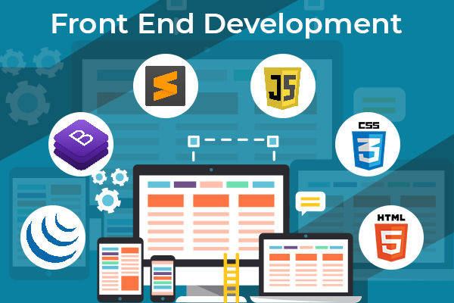
Front end

Slide 7
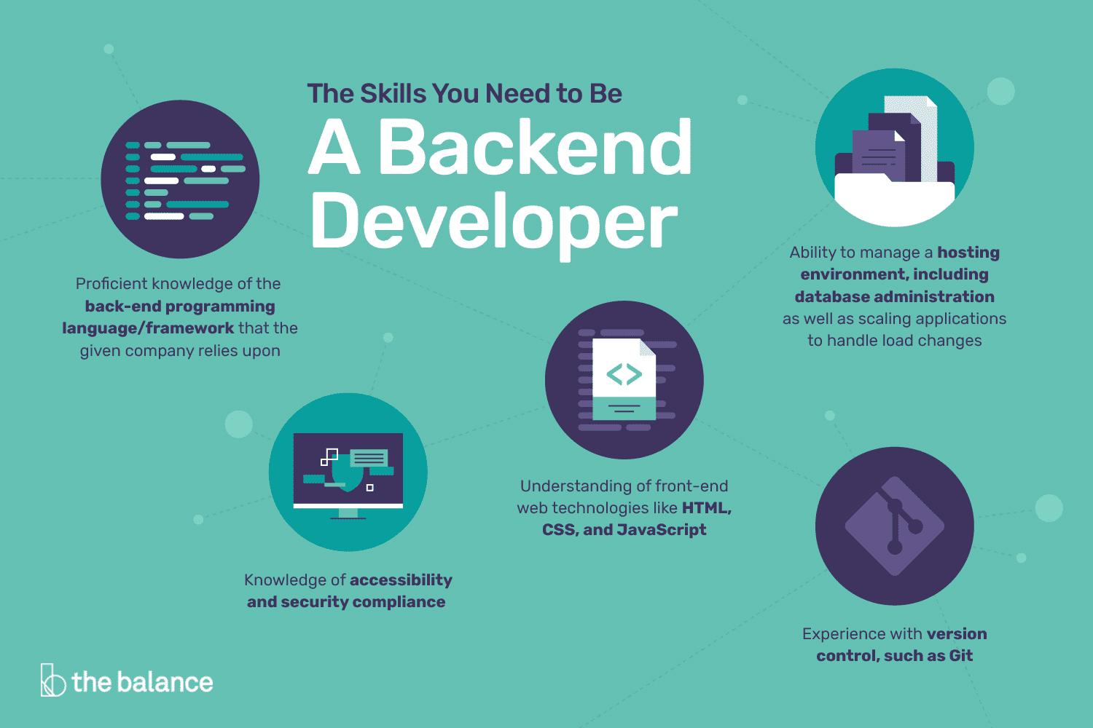
Back end

Slide 8
Modeling
The web development model is a software development model typically used within product internet development for websites, web applications, and mobile applications.
Aweb development model is a way of organizing the different stages of a website’s development so that we can complete them in a coordinated and orderly fashion.
There are several standard web development models, but the most popular ones are front-end, back-end, and full-stack.
Designing a data-intensive Website amounts to specifying its characteristics in terms of various orthogonal abstractions.

Slide 9
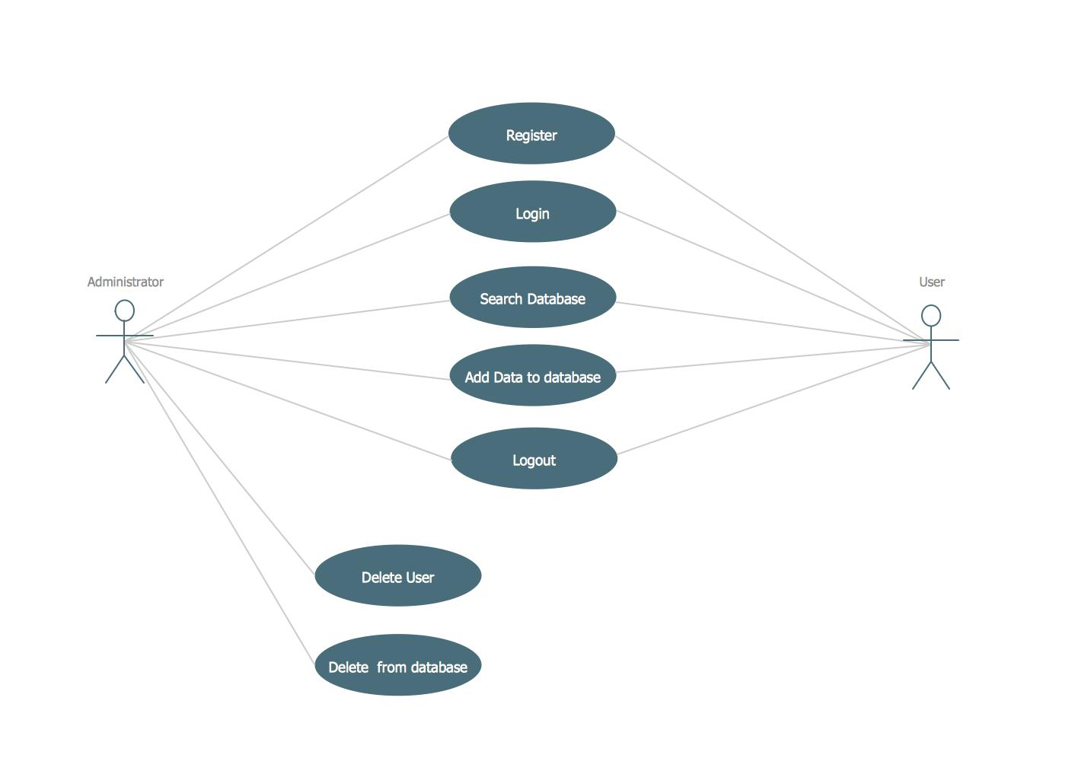

Slide 10
Result
Bus Reservation System is a tool that allows users to book tickets for their journey in advance.
Project Result means the outcome of the Project as evaluated and measured against the Project’s Key Performance Indicators, approved performance deliverables, objectives, targets and key milestones of the Project and any other additional conditions of the above as specified in Schedule 2.
The project life cycle includes five main stages: initiation, planning, execution, monitoring and controlling, and closure.
The project process means a process as a unique action and represents the whole project implementation and the internal processes in the project.

Slide 11
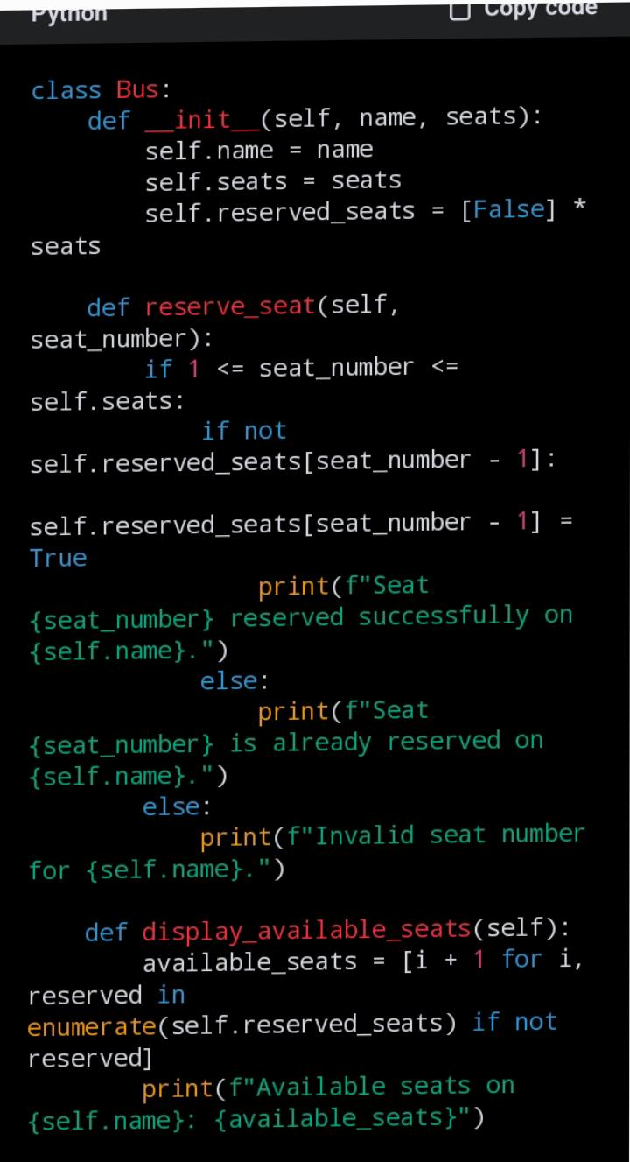
Screen shot

Slide 12
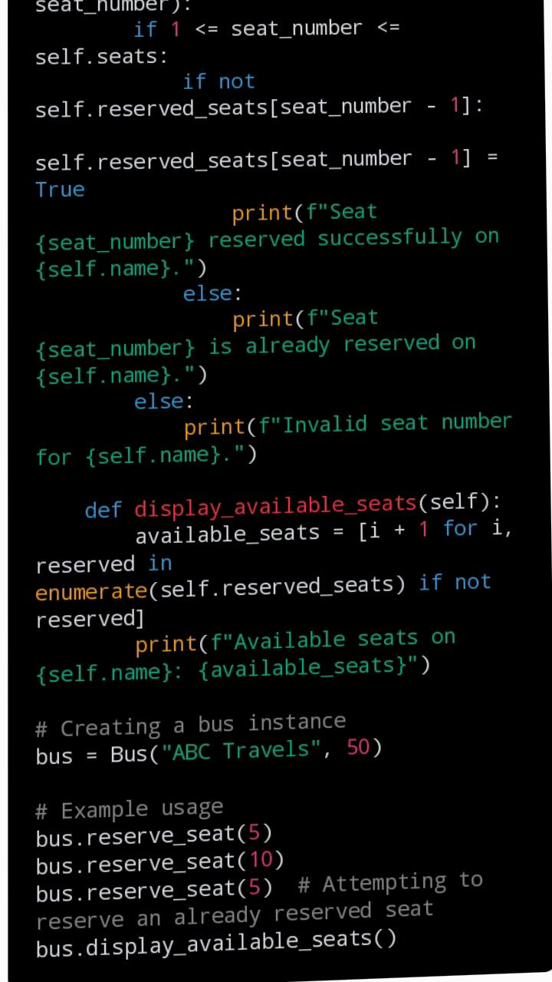

Slide 13
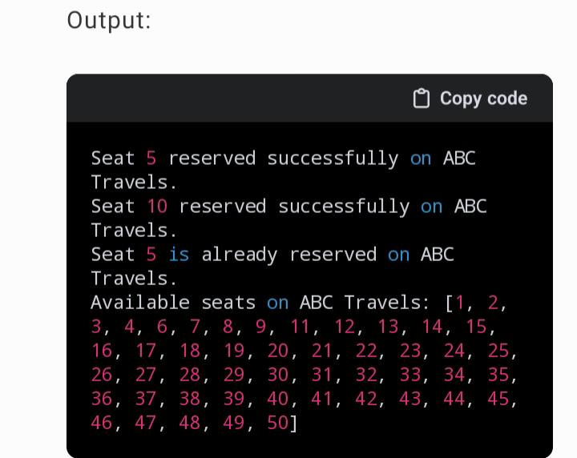

Slide 14
Future enhancement
Online Bus Ticket Reservation System is a Web based application that works within a centralized network.
This project presents a review on the software program “Online Bus Ticket Reservation System” as should be used in a bus transportation system, a facility which is used to reserve seats, cancellation of reservation and different types of route enquiries used on securing quick reservations.
Bus Reservation System is a tool that allows users to book tickets for their journey in advance.
The Bus Reservation System will improve the efficiency, convenience, and comfort of the reservation process.

Slide 15
Conclusion
A bus reservation system is a mobile or web software solution designed to provide customers with a personalized easy-to-utilize user experience for booking and purchasing tickets online.
An online booking system is a software solution and reservation system that makes it simple for guests to book and pay for your tours and activities online
A hotel reservation system works by sending and receiving reservation data, usually in partnership with a property management system and channel manager.
After entering the customer data, they access the calendar and select the most convenient time slot. Next, they schedule an appointment and choose the preferred payment method.

Slide 16
Thank you

